Slide 1
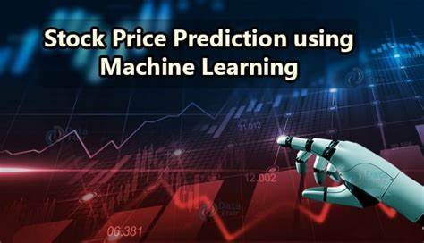
Team ID: Team_2
Team Leader Name: Suraj Kumar Gupta
Team Member Names: Yash Gaur, Mohit Kumar, Ranjit
Team Leader Email: itsurajkr.gupta@gmail.com
Institute Name: DSEU Rajokari

Slide 2
CONTENT
INTERODUCATION
PROBLEM STATEMENT
PROJECT OVERVIEW
WHO ARE THE END USERS?
MACHINE LEARNING
IN PROJECT
WHO ARE THE END USER ?
RESULT
RESULT OF PROJECT(VISUAL)
WOW FACTOR
CONCLUSION
MEET OUR TEAM
END

Slide 3
INTERODUCATION
The goal of this project is to predict the future stock prices of a particular company using historical stock price data and machine learning techniques. By analyzing trends and patterns in the data, we can develop a model that can accurately forecast future stock prices. This project can be useful for investors and financial analysts who want to make informed decisions based on future market trends.

Slide 4
PROBLEM STATEMENT
The objective of this project is to build a machine learning model that can accurately predict the future stock prices of a particular company based on its historical stock price data. The project aims to address the challenge of predicting stock prices, which is a complex and dynamic task due to the various factors that can affect stock prices, including economic indicators, market trends, and news events. By developing an accurate and reliable prediction model, investors and financial analysts can make informed decisions about buying and selling stocks, thus minimizing risks and maximizing returns.

Slide 5
PROJECT OVERVIEW
The stock price prediction project involves the use of machine learning algorithms to predict the future stock prices of a particular company. The project involves several steps, including data collection, data preprocessing, feature engineering, model selection, and model training.
collect historical stock price data
Preprocessed data
machine learning model
predict the future stock prices
determine its accuracy and reliability

Slide 6
MACHINE LEARNING
The stock price prediction project involves the use of machine learning algorithms to predict the future stock prices of a particular company. The project involves several steps, including data collection, data preprocessing, feature engineering, model selection, and model training.
collect historical stock price data
Preprocessed data
machine learning model
predict the future stock prices
determine its accuracy and reliability

Slide 7
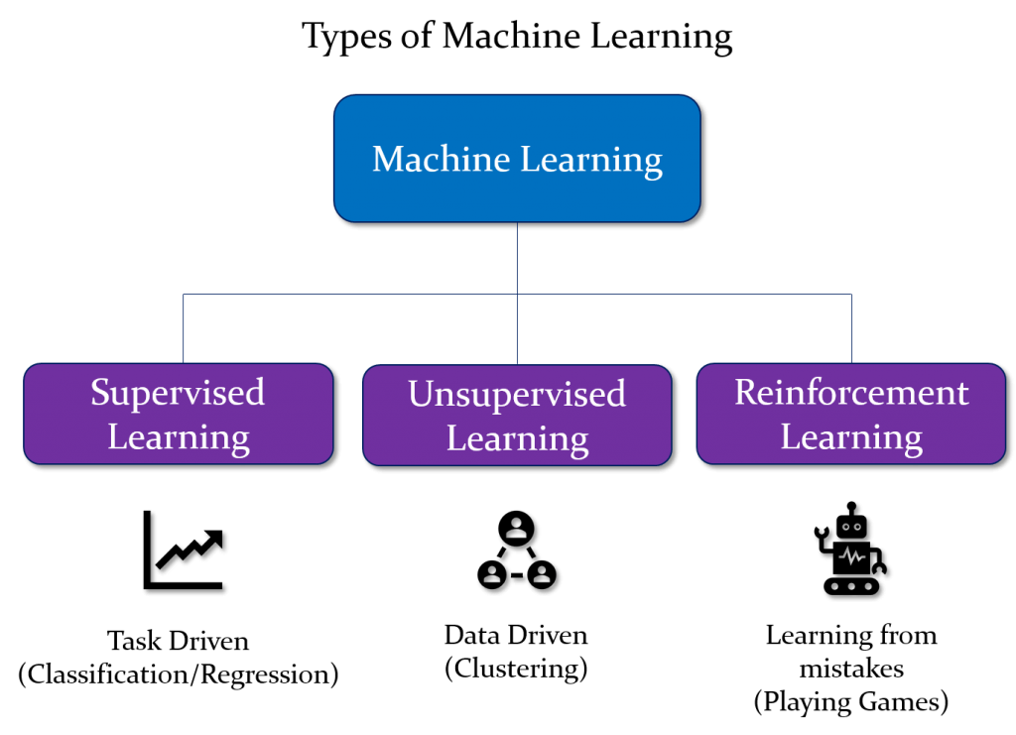
MODELLING

Slide 8
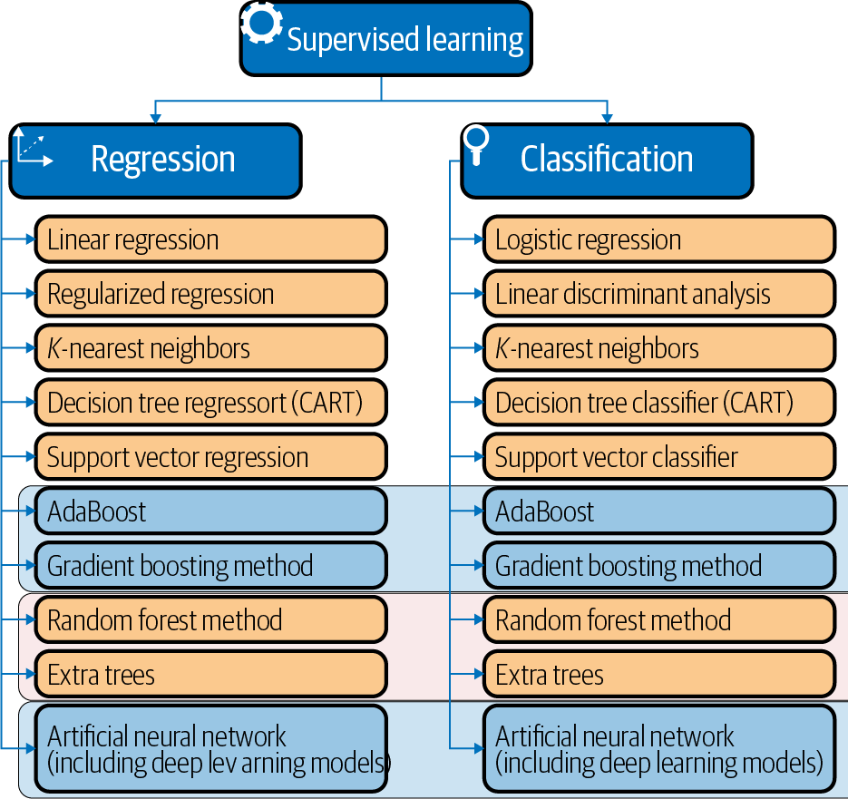
IN PROJECT
Supervised learning is a type of machine learning where the algorithm learns from labeled data, meaning data that has been manually labeled with the correct output or response variable. The goal of supervised learning is to build a model that can accurately predict the output variable for new, unseen input data.

Slide 9
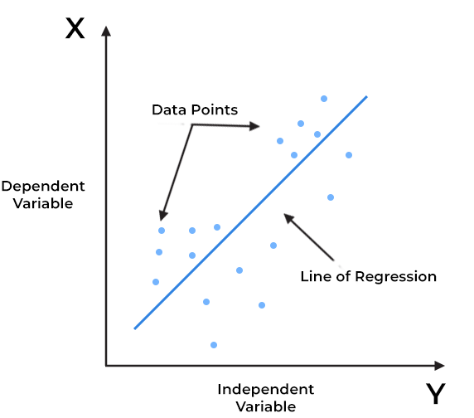
IN PROJECT
Linear regression is a supervised learning algorithm used to predict a continuous output variable based on one or more input features. It assumes that there is a linear relationship between the input features and the output variable, and it seeks to find the best-fit line that describes this relationship.
In linear regression, the goal is to minimize the distance between the predicted values and the actual values of the output variable. This is typically done using the method of least squares, where the sum of the squared differences between the predicted and actual values is minimized.

Slide 10
WHO ARE THE END USERS?
Researchers can use the project to advance the field of machine learning and finance by developing and testing new models and techniques.
Investors can use the predictions to make informed investment decisions and potentially increase their returns.
Companies can use the predictions to make strategic decisions about their business operations and investments, such as deciding whether to issue more shares or invest in a particular market.
Traders can use the predictions to make short-term trading decisions and potentially profit from market trends.

Slide 11
RESULT
To find the result of any machine learning project we need to calculate the accuracy of the model.
To calculate the accuracy of the model, we can compute both the MSE and R2 values using our training and testing datasets and compare them to assess the performance of the model. Generally, a lower MSE, RMSE and higher R2 indicate better accuracy and performance of the model.
Accuracy
r2: 0.9988914672525497
MSE: 261.3601615232374
RMSE: 16.166637297942867
GitHub Link :https://github.com/Surajkrgupta/Stock_Price_Prediction_Using_Machine-Learning

Slide 12
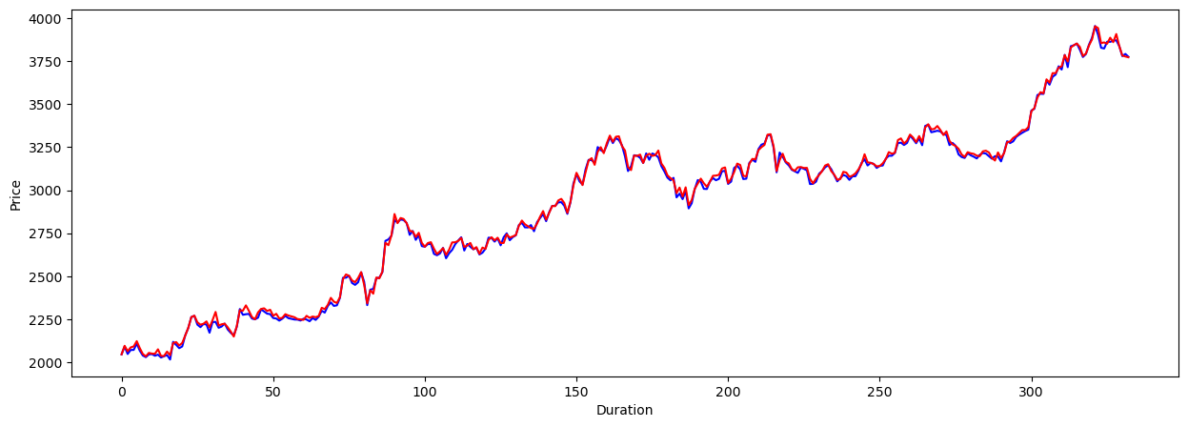
RESULTS OF PROJECT
GitHub Link :https://github.com/Surajkrgupta/Stock_Price_Prediction_Using_Machine-Learning

Slide 13
THE WOW FACTOR IN OUR SOLUTION
The "wow factor" in stock price prediction made by machine learning is the ability to accurately predict future stock prices with a high degree of precision and consistency. Here are some key factors that contribute to the wow factor in stock price prediction made by ML:
Improved accuracy: ML algorithms can analyze vast amounts of data and identify patterns that are not easily discernible to humans. This enables more accurate predictions of stock prices based on historical data.
Improved scalability: ML algorithms can be scaled up or down depending on the size of the dataset and the complexity of the problem being solved. This makes them highly versatile and adaptable to different applications.

Slide 14
CONCLUSION
In this project, we developed a stock price prediction model using linear regression and historical stock price data.
The model was trained on a dataset of historical stock prices for a particular company, and then used to make predictions about future stock prices for that company.
We evaluated the performance of the model using various metrics, including mean squared error and R-squared.
The results of our analysis suggest that the model has potential for predicting future stock prices, but further refinement and evaluation may be necessary to improve its accuracy and usefulness.
Overall, the stock price prediction project demonstrates the potential for using machine learning algorithms to make informed predictions about future market trends and help investors, traders, and companies make strategic decisions.

Slide 15




MEET OUR TEAM
SURAJ KUAMR GUPTA
YASH GAUR
MOHIT KUAMR
RANJIT

Slide 16

END

